Slide 1

The Ultimate NFL GameDay Experience

Slide 2
Agenda
The Now
Main Objectives
Project Life Cycle
Marketing Plan
Financials
Implementation of Plan
Contingency Plan

Slide 3
Main Objective
Digitalize the NFL Gameday Experience
Transform our Social Media Platform
Create an Interactive Augmented Reality
Combine NFL and fantasy football app
Install Geographical Interactive Map
Highlight Social Promotions of the Week
Observe First Person POV
Access Detailed Data Play by Play
Notes:
Create greater market share for the NFL against other unofficial products
Translate the NFL gameday experience to the digital realm
Make NFL stats immediately available for fans in an innovative way
Summation: Create the ultimate multi-channel experience for fans in the stadium, at home, and on-the-go

Slide 4
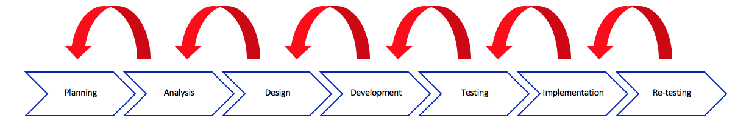
Project Life Cycle
Who?
Software Development Team
Data Analysts
Consultants
Project Management Leader
How?
Measured by EBITDA
Annual analysis
Notes:
Agile methodology= the process of going back to the step before

Slide 5
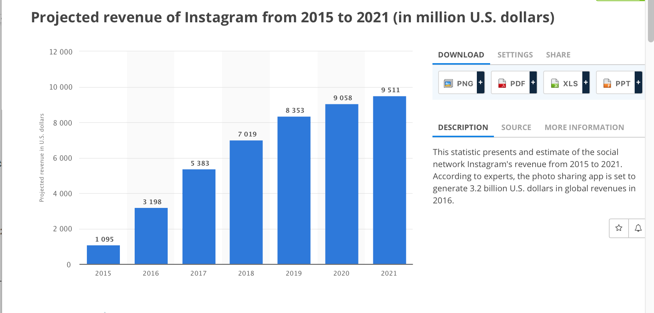
Marketing Plan
Who
Ages 18-49
What
Repurpose NFL products
Forced promotion on update
Target augmented reality to top 10 teams and players with top TD’s
Retargeting and commercial ads after 1 year
Result
Increase subscribers by 5% monthly
Expand digital network to reach 7 million new users of the app by 1 year
Notes:
Instagram introduced the “instagram story” in 2015 and doubled its revenues
73.5% of this age group uses social media
NFL total digital following: 32,325,000

Slide 6
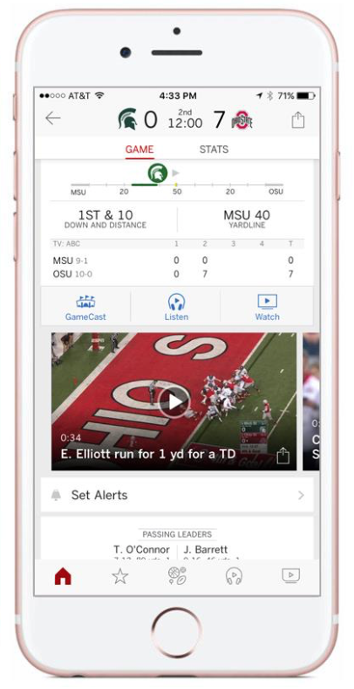
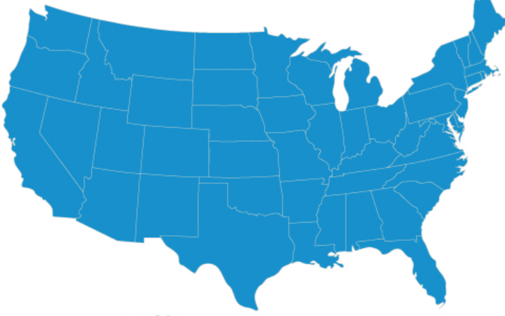
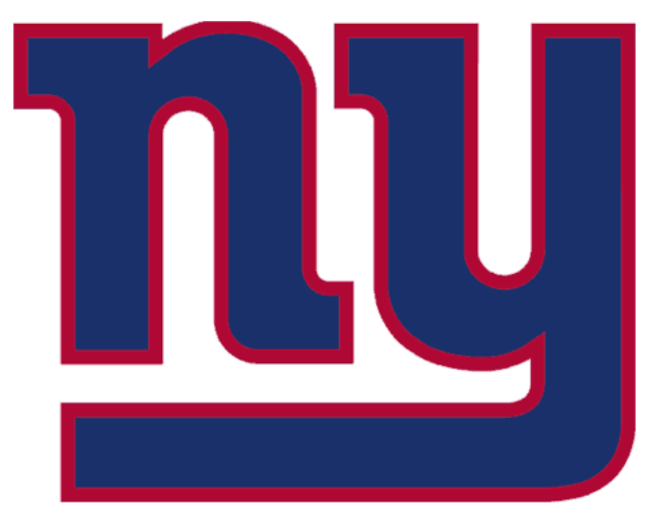

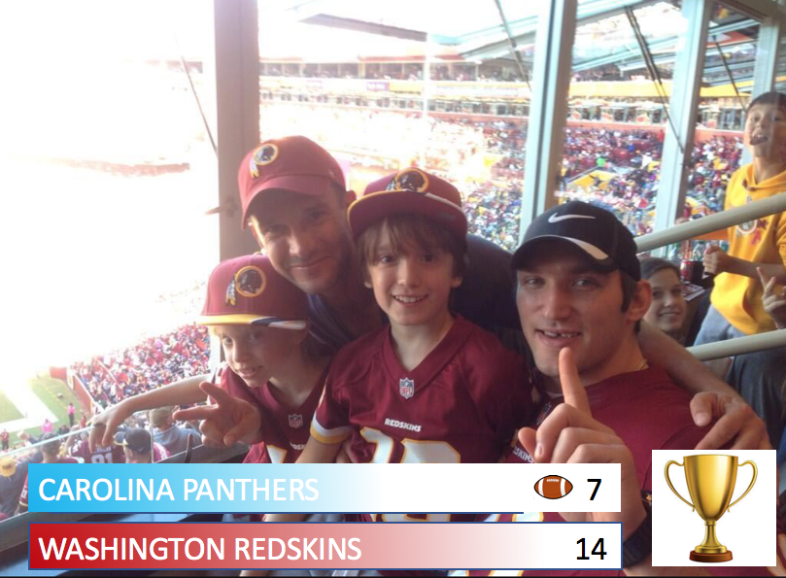


Social Media
What we will do:
Combine fantasy football and NFL mobile app
Connect fans at home with those at the game
Encourage inter-team rivalries
What competitors do:
Live scores and highlights
Separate fantasy and ESPN app
No interactive material
Dependent on subscribers for 60% of revenue
Notes:
nice!
Will decrease subscribers by creating completely new and interactive app and by combining the fantasy football app and the pre-existing NFL app

Slide 7

Augmented Reality
Main Idea
1st Person POV
Pilot: Patriots, Giants, Cowboys, Redskins, 49ers
Importance
Brings the stadium experience to the everyday fan
Notes:
Augmented Reality is a new field and we want to be pioneers-- if we don’t take this one, someone else will
People will get to see the point of view of the player, experience plays, see their stats
Cool for fans but also useful for coaches
Future of player development and fan interaction is virtual reaction
Already have go pros and google glasses

Slide 8
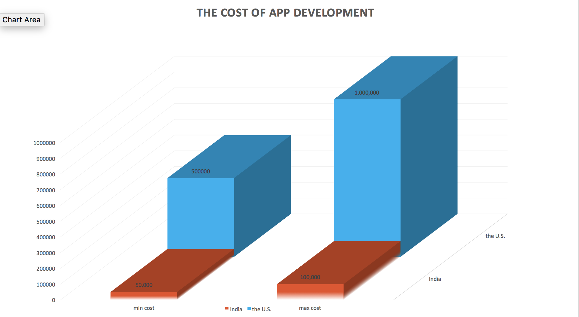
Financials - Cost
Resources: | Cost:
Equipment(GoPro) | 499X20=10,000
Maintenance 5 programmer fix bugs | $10,000 per month
Support team | $20,000 per month
Application | $50,000
Total | $120,000
The Cost of App Development
https://www.apple.com/newsroom/2016/05/18Apple-Announces-New-iOS-App-Design-and-Development-Accelerator-in-Bengaluru/
Notes:
“Value proposition”
http://www.businessinsider.com/india-is-10x-cheaper-than-us-for-app-development-2017-1

Slide 9
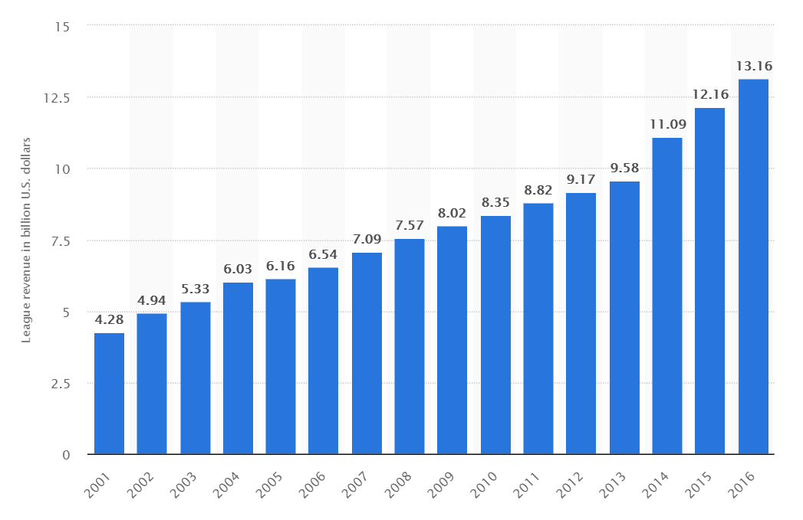
Financials - Net Income
Purchased app features (by consumer) | Price (per app feature) | Consumer (estimation of uses X percentage of app users)
No ads - NFL Basic | $0.99 | 6M*7% = $415800
No ads + Real time statistics | $1.99 | 6M*3% = $358,200
Augmented Reality | $3.99 | 6M*1% = $239,400
Total Revenue |  | $1,013,400 + Revenue from new users
Total Cost |  | $120,000
Total Revenue of all NFL Teams
6 Month Projection: $360,000 - $120,000*3 + $1,013,400*3 = $2,320,200
5 Year Projection: $100,417,361
Notes:
-360,000 - 120,000*3 + 1013400 *3 = 2,320,200
(2,320,200)(1+0.025/12/60)^5 = 100,417,361 - compounded annually using p(1+r/n)^t - 5 percent growth per month

Slide 10
Risk Assessment
Event: | Impact:
1. Destruction of cameras | High
2. Low interest in virtual reality | Medium
3. Lack of awareness | High
Solution: | Cost of implementation:
1. Replace camera | Low
2. Sponsorships | High
3. Promotional videos | High
Notes:
Destruction of cameras on players due to hard collisions
No interest in social media aspect of the NFL

Slide 11
Conclusion
Bring the game day experience to your home
Pilot program for 1 year
Introduce augmented reality
Low risk, high reward
Notes:
With the combination of “my game day story” and the AR platform, users are getting both a player perspective and a fan perspective. This is a complete experience and view of NFL sunday.
The marketing plan is broad and can be used with focus groups to test the hypothesis. It the can be adjusted semiannually in relation to actual versus perceived revenues.
The cost of developing this plan is not high due to outsourcing. This allows for a product that can return a high value cheaply.
Since the cost is low, the risk is low.

